Slide 1
Sentiment Analysis of Tweets

Slide 2
Problem Statement
Identifying the sentiment about the product/brand on basis of tweets fetched from Twitter.

Slide 3
Data
The train data consists of around 7k tweets/responses with sentiment label.
Feature | Feature_Type | Description
tweet_id | Numerical | ID allotted to a tweet
tweet | Object | Tweet made by the user
sentiment | Numerical | Sentiment of the tweet. 0 : Negative 1 : Neutral 2 : Positive 3 : Can’t tell

Slide 4
Evaluation Metric
The evaluation metric for this project is “weighted” f1 score.
The F1 score can be interpreted as a weighted average of the precision and recall, where an F1 score reaches its best value at 1 and worst score at 0. The relative contribution of precision and recall to the F1 score are equal. The formula for the F1 score is:
F1 = 2 * (precision * recall) / (precision + recall)
“weighted” F1 :
Calculates metrics for each label, and find their average weighted by support (the number of true instances for each label).

Slide 5
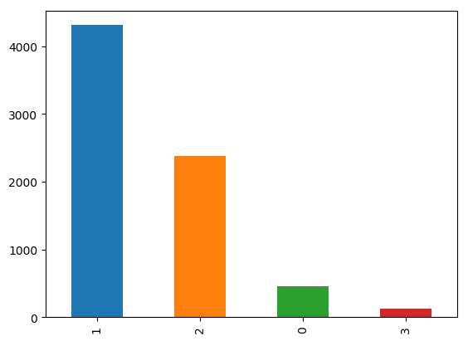
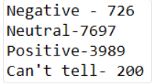
Pipeline
Class Imbalance : The distribution of the target variable shows a clear imbalance in the 4 classes.

Slide 6
Challenges:
HTML encoding: Since HTML encoding hasn’t been converted to text, data contains ‘&amp’,’&quot’,etc.
’@’ mention: It includes information about user that tweet mentioned but doesn’t add value to build sentiment analysis model.The data contains about 5366
URL links:
hashtag: The data contains about 12685 hashtags.
Negation handling:

Slide 7
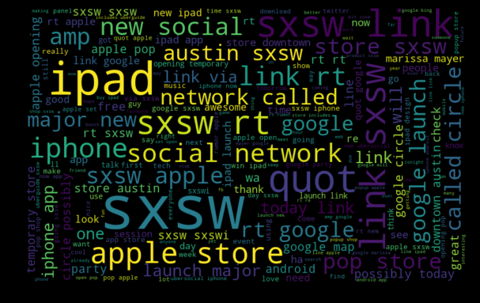
Preprocessing Approach
Processing of text data
HTML Decoding.
Removal of Twitter id
(@) .
Removal of URL links/address.
Lower_case.
Removal of numbers and special characters.
Negation handling.

Slide 8
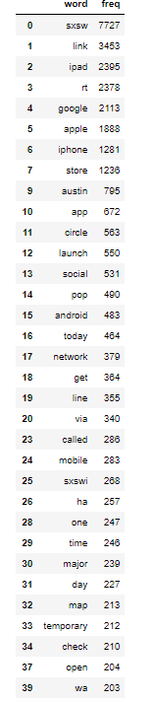
Removed words having frequency more than 200 while keeping those which could/would have an impact on sentiment analysis

Slide 9

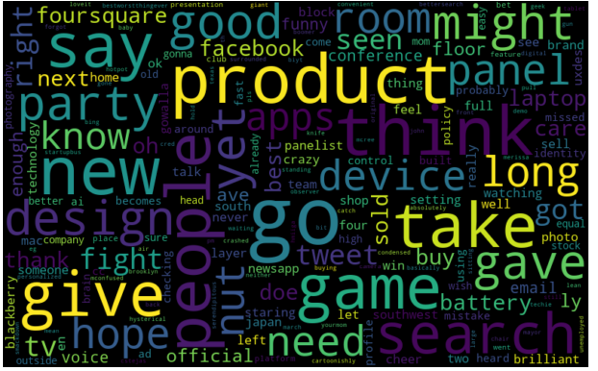
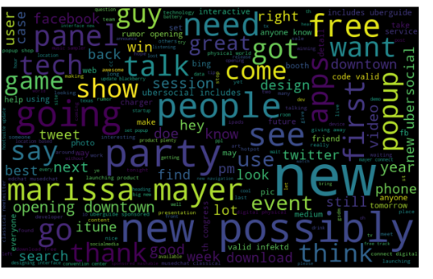
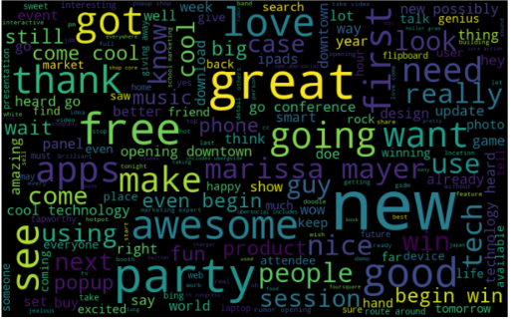
Sentiment=0(negative)
Sentiment=3(Cant talk)
Sentiment=1(neutral)
Sentiment=2(positive)

Slide 10
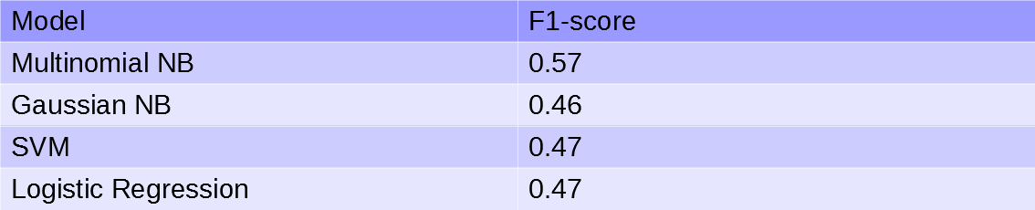
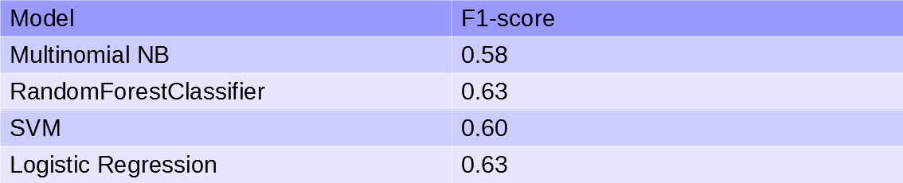
Models
Without smote:
With smote:

